Slide 1
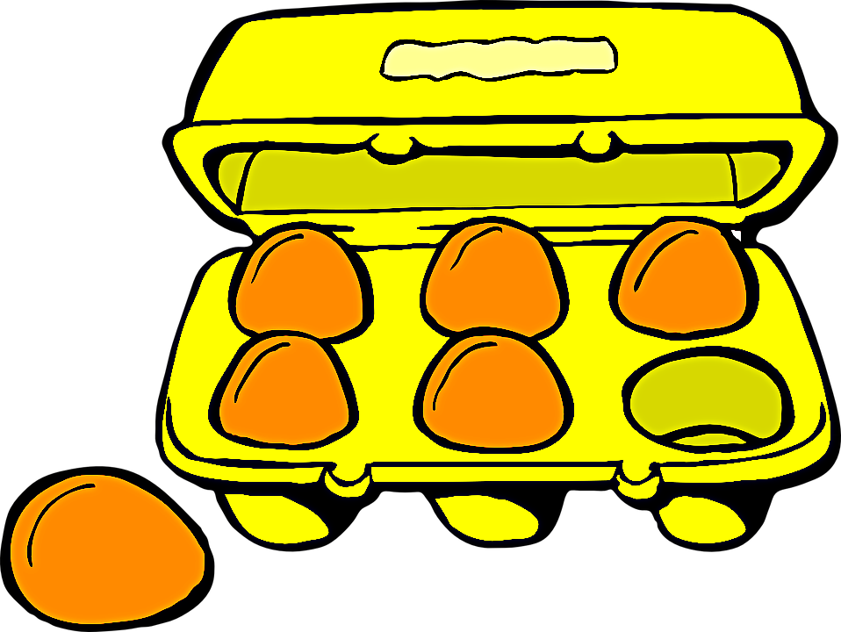

Eggs
MCQ
BIN
Eggs
Yes
Can Lay
Bombs
No
Chicken (Hen)
Bombs

